Slide 1
Secure Data Hiding in Image Using Steganography
CAPSTONE PROJECT
Presented By: Shivaji Singh
Student Name : Shivaji Singh
College Name: Usha Martin University
Department : Computer Science and Engineering

Slide 2
OUTLINE
Problem Statement
Technology used
Wow factor
End users
Result
Conclusion
Git-hub Link
Future scope

Slide 3
Problem Statement
"The image of the "Steganography" image, which hides the decryption key, is "safe data" that allows you to extract information. This will minimize visual distortion in the carrier image and resist attempts to identify the presence of hidden data. " Key aspect of the instruction in this issue: Invisibility: Do not display hidden data when viewing modified images. Security: Responds to support Only certified users with keys should be able to extract hidden data. Robustness: The hidden data is also exposed to common operations such as changing, compression, and adding noise. If so, it must remain intact. Considering potential challenges: Recognition algorithm: Development of methods of resistance to existing Stegan analytical techniques that attempt to identify hidden data in images. Image quality: Compensation for the amount of data built into the maintenance of visual quality of carrier images. Key Management: Distribution and management of decryption keys to authorized users. Possible approach to solving this problem: Operation (minimum significant bits): The minimum effect on the visual appearance is minimal, so the minimum from the pixel values ​​of secret data Change the bit of the. Frequency Domain: Hide data in the frequency components of the image using transformations such as discrete cosine transform (DCT). Adaptive embedding: Adaptive embedding process based on local properties of the image to optimize invisibility. Encryption: Encrypt secret data before embedding to improve security.

Slide 4
Technology used
We used python Language.
We used libraries :
CV2
String
Operating system
We used :
4Gb of RAM
Windows 10
We used windows platforms.

Slide 5
Wow factors
The uniqueness of a steganography project depends on the aspects that distinguish existing methods. Here are some unique features that can highlight my project:
1.Hide data more efficiently: - Quantum Braceing Icing: Integrates the encryption quantum principle of ultra-security communications, if applicable. - Multilayer-Code: Use multiple bridge organography techniques simultaneously (LSB + DCT + Spread spectrum). 2. - Dynamic Key Production: A system is implemented that generates clear keys for each transmission instead of static keys. - Operation detection: Implement test amount or hazing techniques to recognize unauthorized changes.
3.Cross-Media Steganography: - Multi-format support: Not only in photos, but also in audio, video, PDF, and even 3D models. Hybrid Steganography: Combine several media types (e.g. embedding data in both images and accompanying audio files for additional security).
4. Cloud-based Services: A web or mobile application that allows users to extract embed and hidden messages. 5. Compression & Rausch - robustheit : Make sure that hidden data is not lost during image compression (JPEG), filtering or scaling. - Adaptive payload is hidden: Embedded strength is dynamically based on image complexity to maximize security. 6. User-Friendly and Scalable Features: - GUI-based Implementation: Interactive interface for non-technical users. - Steganographic Chat Application : A messaging platform that integrates Hidden News Communication. - Blockchain Integration: Store hidden messages in distributed ledgers for additional security.

Slide 6
End users
Steganography end users vary by application and context. Common end-user categories include:
Cybersecurity Professionals – Use steganography for secure communication, watermarking, and digital forensics.
Government and Military Agencies – Utilize steganographic techniques for covert communication and protecting classified information.
Journalists and Whistleblowers – Hide sensitive data within media files to avoid detection while reporting confidential information.
Corporate Users – Protect intellectual property, watermark digital content, and secure internal communications.
Researchers and Academics – Study and develop new steganographic techniques for security, digital rights management, and AI applications.

Slide 7
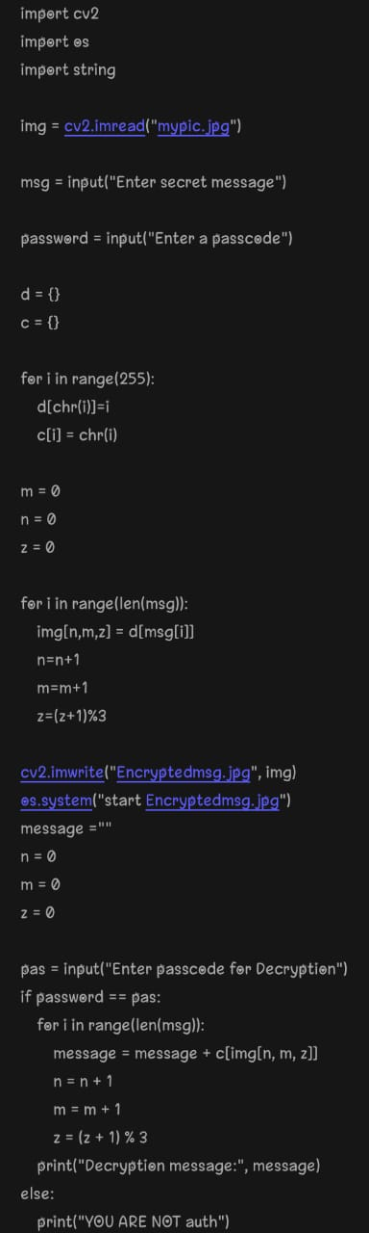
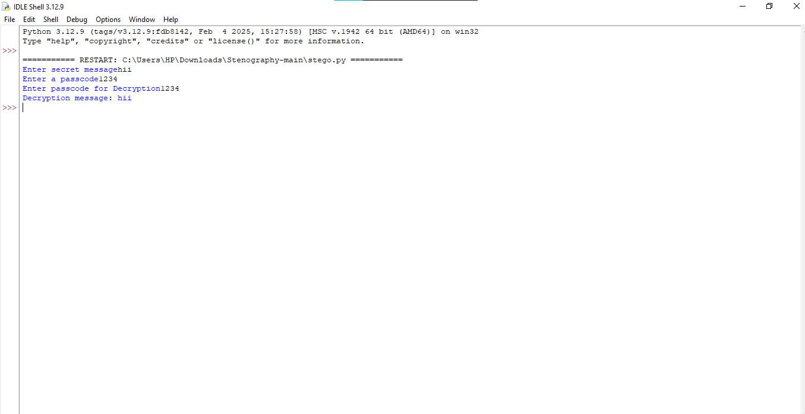
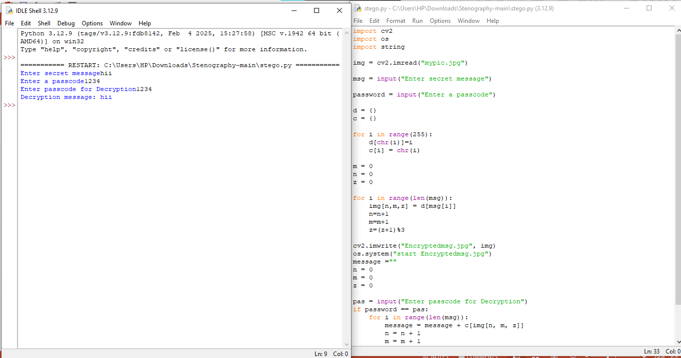
Results

Slide 8
Conclusion
The conclusion based on the provided text of Steganography is that Steganography aims to safely hide data in digital media, maintain visual quality, and resist detection. The most important considerations include invisibility to ensure that hidden data is not easy to see. Security so that only certified users can extract data. Robustness to allow hidden data to withstand collaborative operations such as compression and noise. Challenges include developing recognition algorithms to combat STEG analysis, maintaining image quality despite the secure management of embedded data and computer keys. Possible solutions include minimal critical bit manipulation for minimal visual effects, domestic conversion of frequencies such as DCT, optimized invisibility and encryption to improve safety before embedding Adaptive embedding is included for.

Slide 9
GitHub Link
https://github.com/Shivajisingh001/Steganography-Project.git

Slide 10
Future scope(optional)
Future Areas of Steganography The realm of Steganography is constantly developing with advances in terms of computers, artificial intelligence and cybersecurity

Slide 11
THANK YOU

